Slide 1
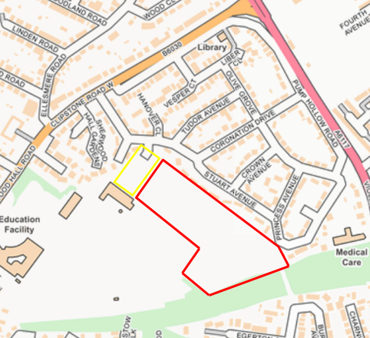
Proposed Residential Development
Stuart Avenue, Mansfield, Nottingham
Nottinghamshire County Council are seeking the views of the local community to help shape the proposals to deliver housing that is needed in the area.
Aspbury Planning Ltd is preparing an Outline Planning Application for a residential development for up to 52 dwellings and a parking alleviation scheme, to be submitted to Mansfield District Council on behalf of Nottinghamshire County Council (NCC) on land at ‘the former Sherwood Hall School Playing Fields’.
Nottinghamshire County Council invites you to submit written comments for consideration by the project team to shape the development of the site.
Comments can be submitted via the webpage: www.aspburyplanning.co.uk/public-consultations/
or by sending an email to: office@aspburyplanning.co.uk
(quoting "Stuart Avenue" in the subject line).
Please note the deadline for comments is Wednesday 5th June 2024.

