Slide 1
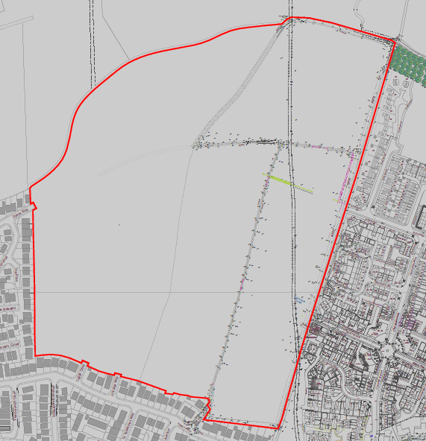
Proposed Residential Development
Land to the west of Lumley Fields, Belton Park Road, Skegness
Manor Crest Homes Ltd are seeking the views of the local community to shape the development of the site.
Development of up to 515 dwellings, with a proportion of affordable homes and a Community Hub/Teaching and Learning Centre, together with 7.52 ha of open spaces, drainage infrastructure and a pedestrian/cycle link.
Manor Crest Homes Ltd invite you to comment and help shape the development. Further information can be view at https://www.aspburyplanning.co.uk/planning-consultations/
Comments can be sent via the ‘Comment’ facility on the website or by sending an email to: office@aspburyplanning.co.uk
(quoting “Skegness”) in the subject line.
Please note that the deadline for comments is 23 12 2022

